Slide 1
Android Custom Keyboard
A smart and intelligent android keyboard

Slide 2
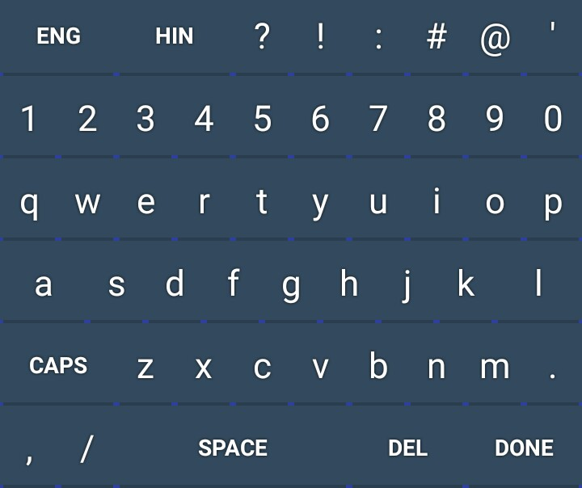
Android sdk
This is an android keyboard and can be installed in any android phones.
But currently we are targeting minimum api level 19 i.e., android kitkat.
Technology used :- Android Studio, Google API

Slide 3
It is a custom keyboard which has almost all basic inputs (letters and numbers)
It has also two extra key, one is ENG and other is HIN.
ENG and HIN allows user to type in English and Hindi script respectively.
Translation from hindi to English are done using google api.

Slide 4
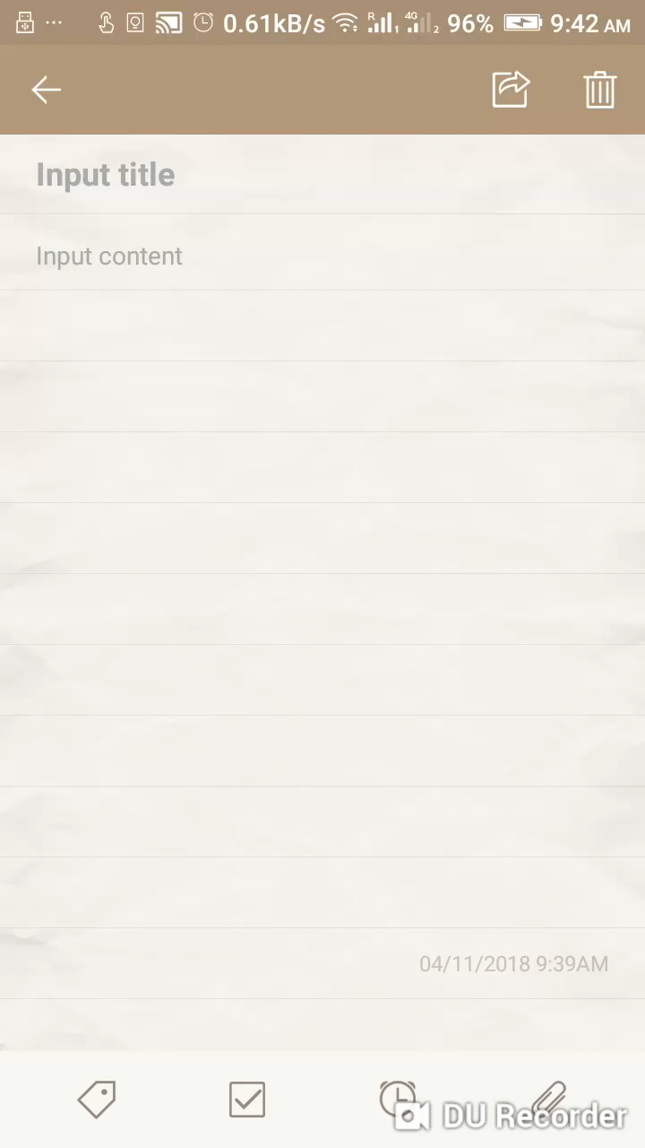
Demo of our android custom keyboard

Slide 5
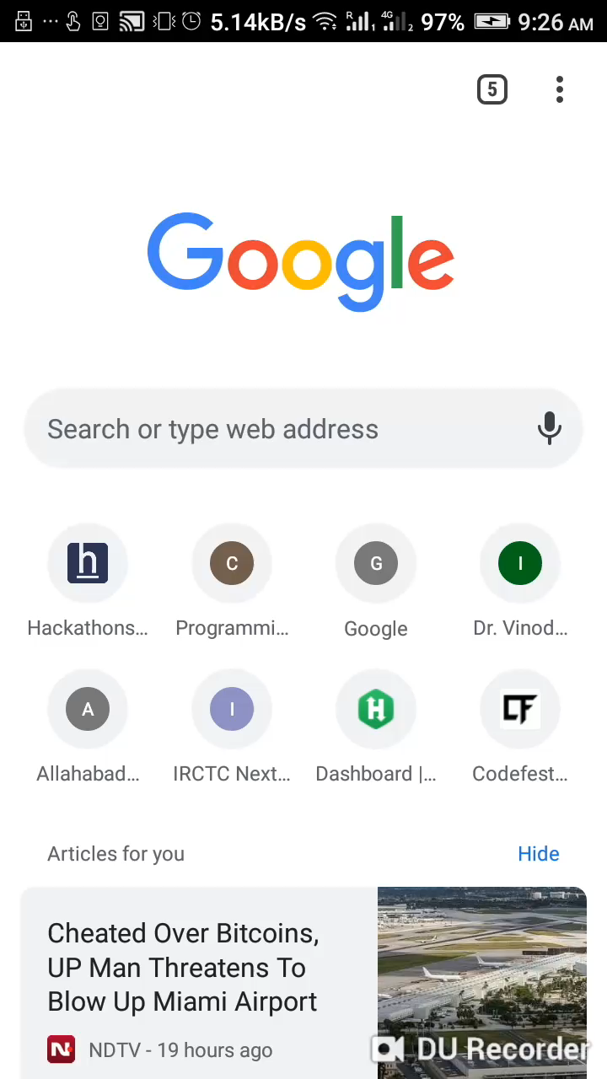
Some of the basic Hindi words which are detected or not detected by google itself.

Slide 6
Thank you for watching

